Slide 1

Credit Card Transactions Fraud Detection
Simulated Credit Card Transactions generated using Sparkov

Slide 2

Agenda
Problem Definition.
Dataset Description and Handling Our Dataset.
Traditional Machine Learning Models.
Ensemble Learning Models.
Results.
Summary.

Slide 3
Problem Definition
Credit card transactions are one of the most business-critical problems because we deal with personal and critical information, and we also deal with the highly skewed nature of the dataset because fraud transactions are very smaller than natural transactions, so we deal with unbalanced data and target the small class, so it is a challengeable problem.
Fraud can be avoided in two ways:
Fraud Prevention.
Fraud Detection.

Slide 4

Dataset Description. Handling Dataset.
Dataset Description.
This dataset of simulated credit card transactions includes both genuine and fraudulent transactions that occurred between January 1 and December 31, 2020. It includes transactions made with a pool of 800 businesses using the credit cards of 1000 customers.
The dataset splits into two main files fraudTrain.csv and fraudTest.csv and contains 23 features.
Handling Dataset
Data Engineering and EDA contain:
Check null values.
Check Data imbalanced.
Handling Imbalanced data.
Handling Object columns.
Check and handle outliers.
Feature Selection.

Slide 5
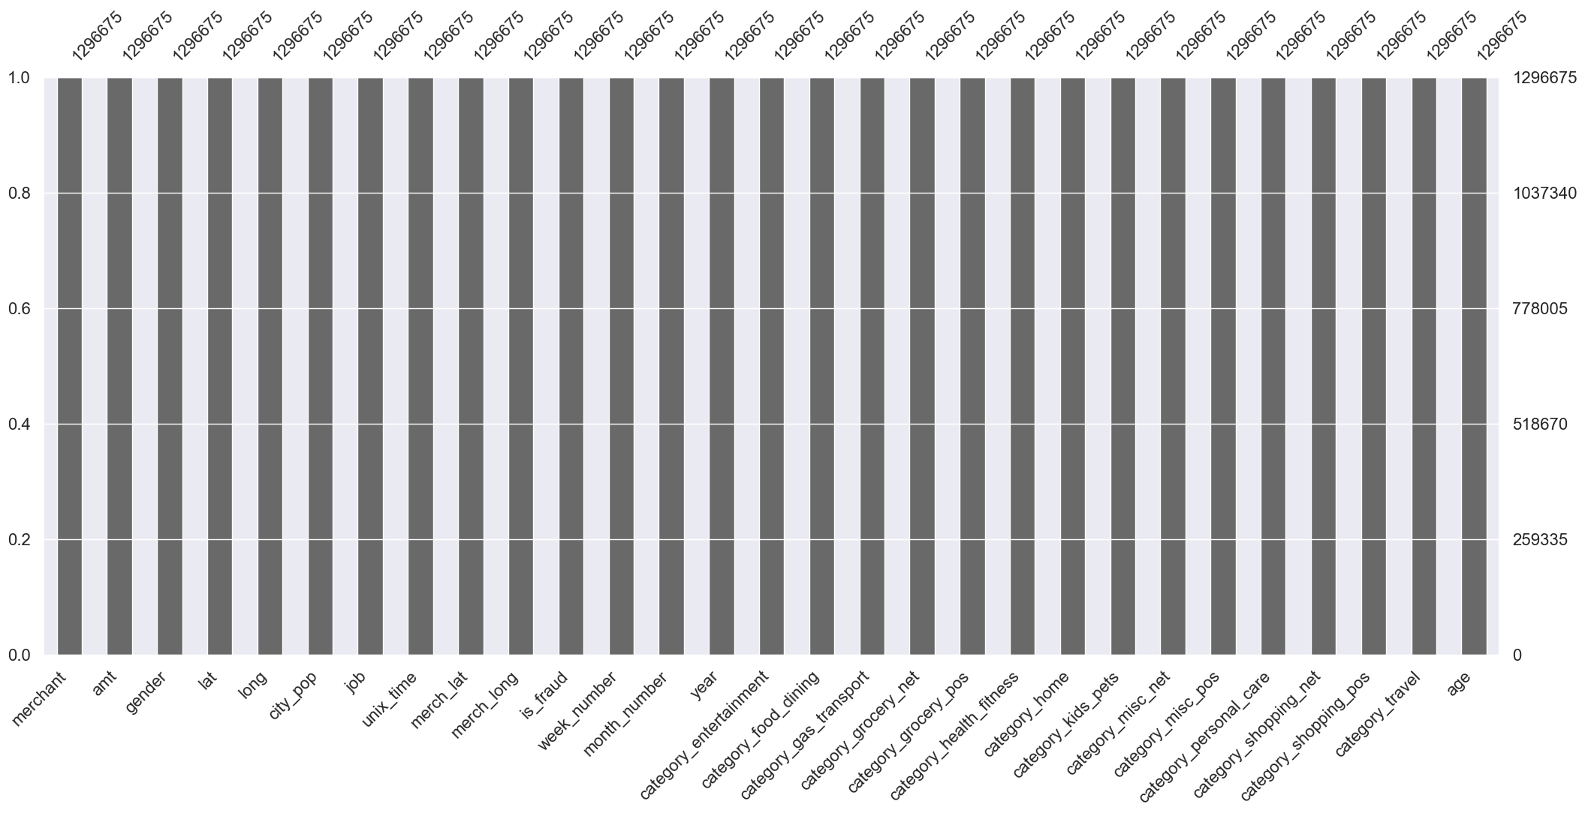
Check Null Values
Our dataset does not contain any null values.

Slide 6
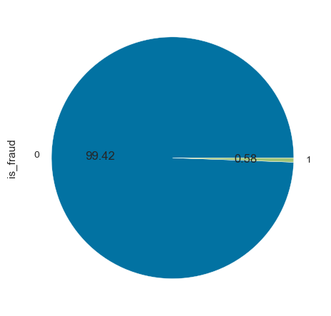
Check Data imbalanced
Our dataset is unbalanced because:
We have imbalanced samples between 2 classes(0 and 1).
We target the minority class(1).

Slide 7
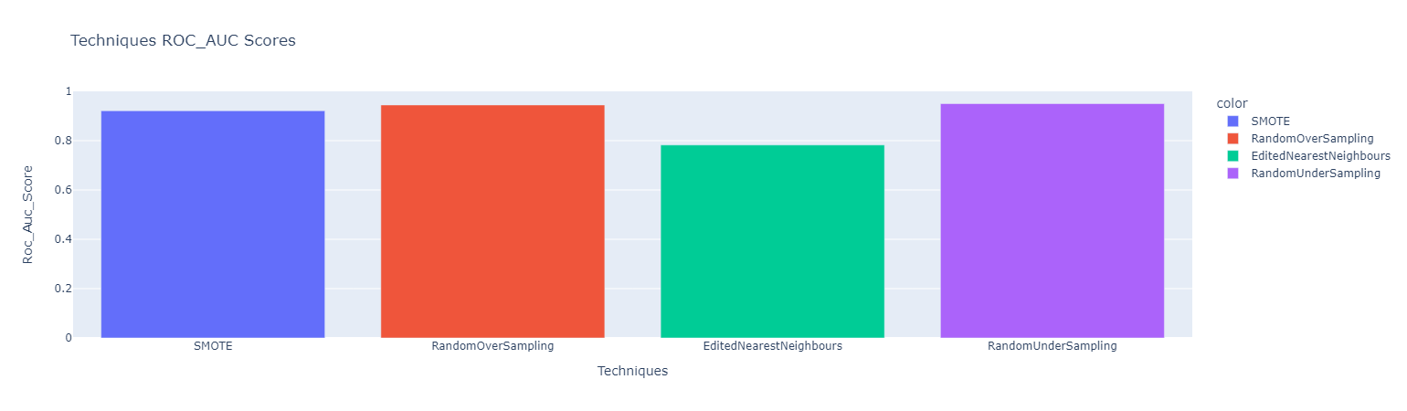
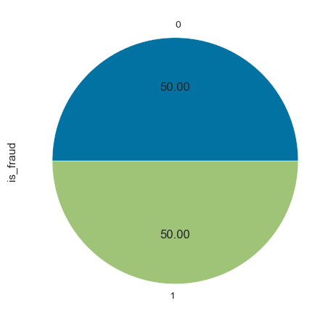
Handling Imbalanced Data.
Handling Imbalanced problems using four techniques:
Smote.
Random Over Sampling.
Edited Nearest neighbours.
Random Under Sampling.
We use PCA to reduce the dimension of our dataset to 15 features because Imbalance techniques can generate data for only 15 features and our dataset is exceed this limit.
The best technique that gave us a high roc_auc score was Random Under Sampling

Slide 8
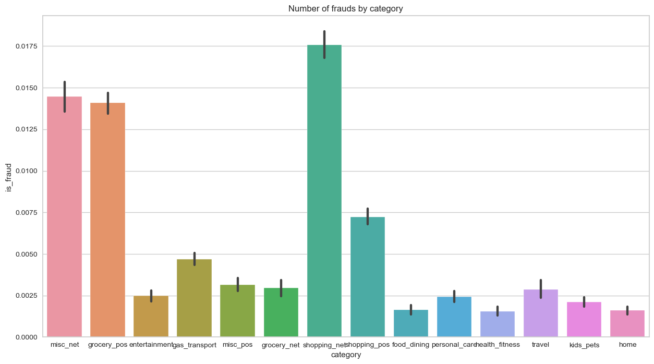
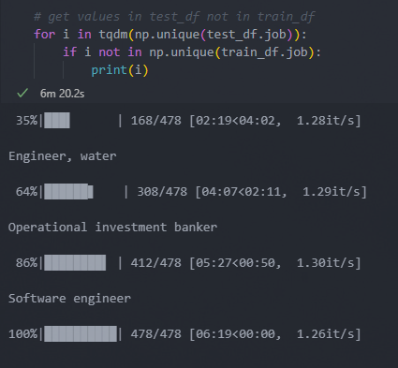
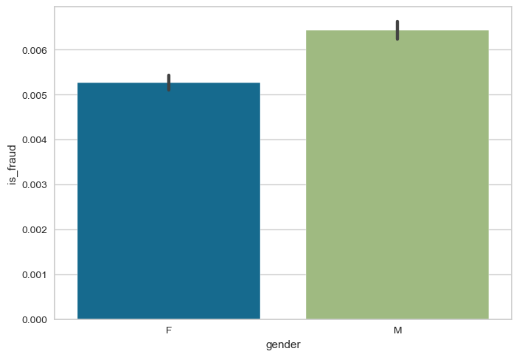
Handling Object Columns.
In this part, we use a different technique to handle object ‘String’ columns like:
Label Encoder.
One Hot Encoder.
Hashing.

Slide 9
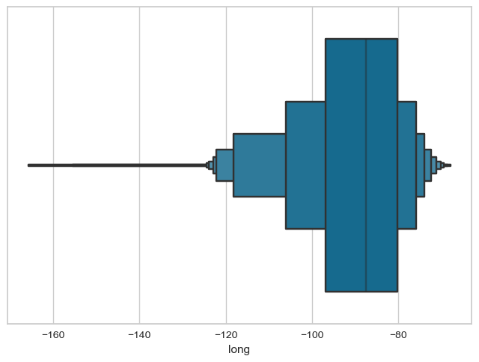
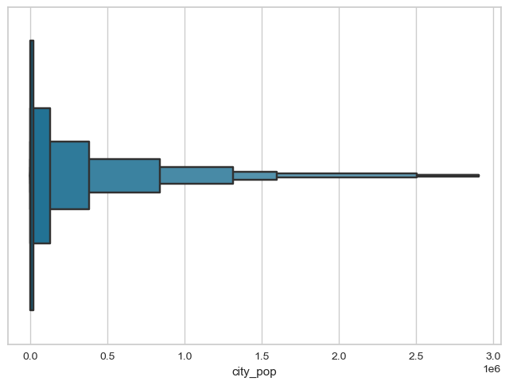
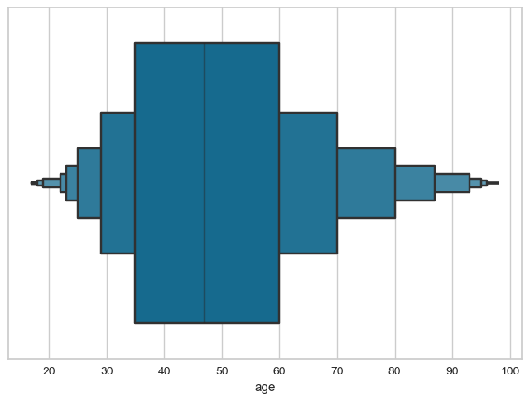
Check and Handling Outliers
It’s noticed that our dataset contains outliers so we use the Robust scaler to reduce the effect of outliers.

Slide 10
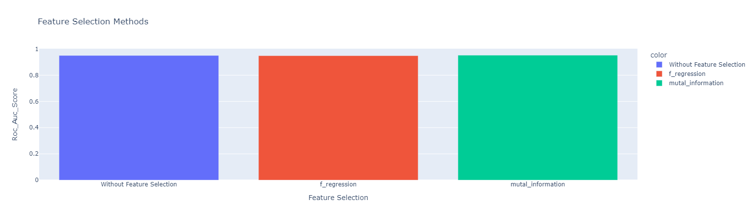
Feature Selection
Feature selection methods:
Mutal Information.
F-Regression.
Mutal Information gave us a high roc_auc. score.

Slide 11
Traditional Machine learning models
1

Slide 12
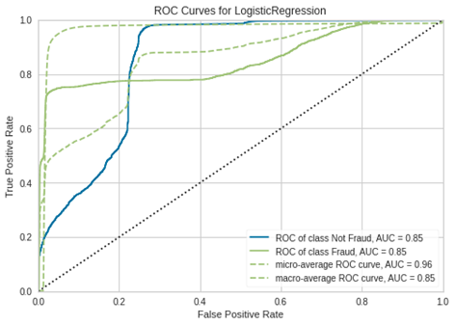
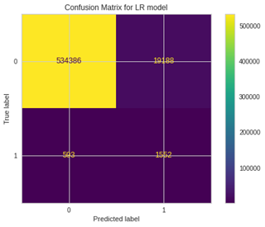
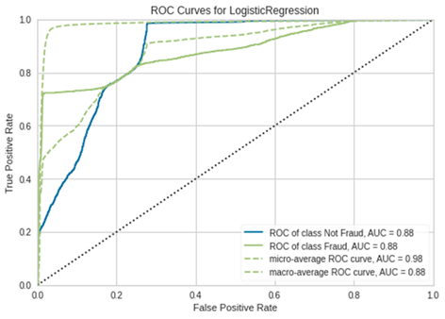
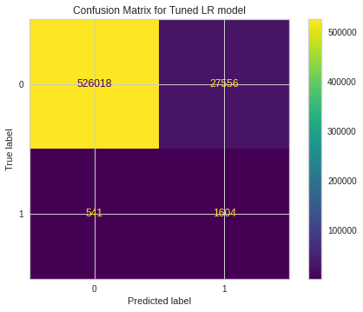
Logistic Regression
By using Logistic Regression to estimate the probabilities of the output being fraudulent or not. We tuned the LR to improve the performance the accuracy is 96.4%

Slide 13
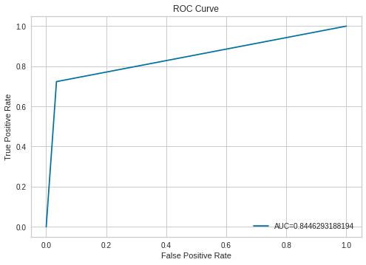
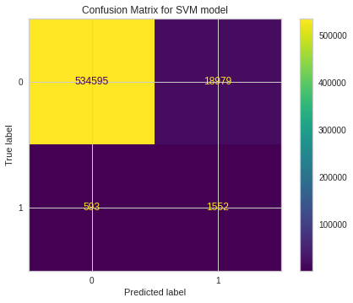
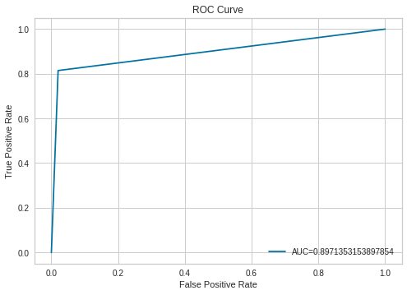

Support Vector Machine
Use another classification model Support Vector Machine to classify whether the output is fraudulent or not. We also, tuned the SVM to improve the performance, the accuracy is 96.4%

Slide 14
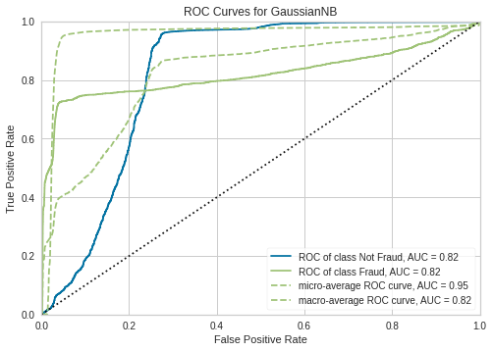


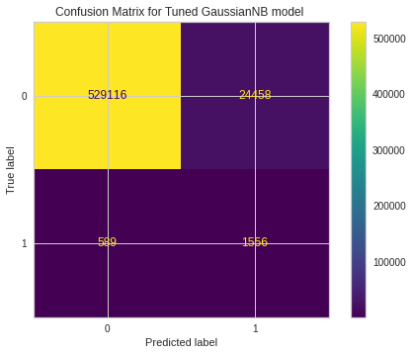
Naïve Bayes
Try another classification model Naïve Bayes to compute the probability to detect whether the output is fraudulent or not. We also, tuned the NB to improve the performance, the accuracy is 95%

Slide 15
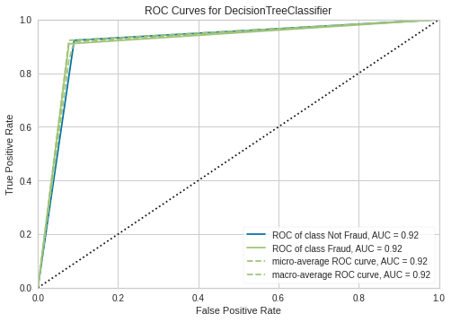
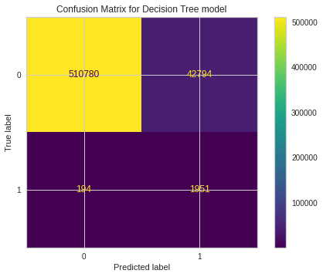
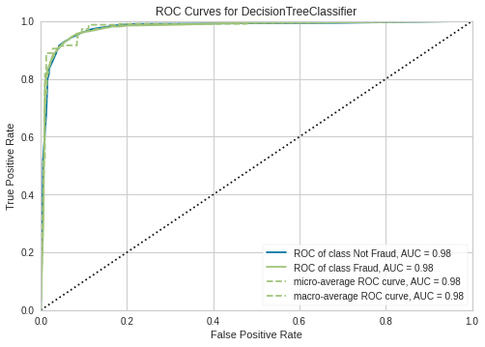
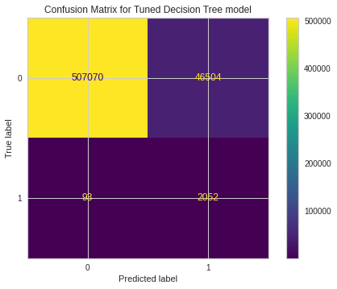
Decision Tree
Also we use the Decision tree to classify and detect whether the output is fraudulent or not. We also, tuned the DT to improve the performance, the accuracy is 92.2%

Slide 16
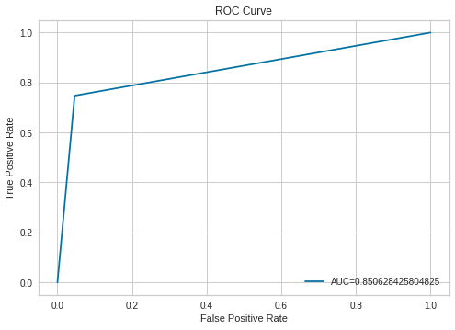
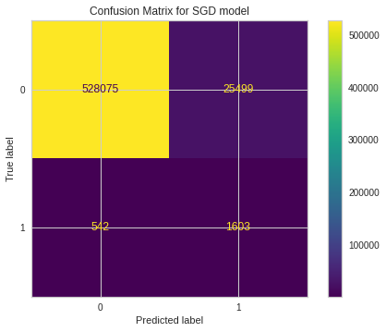
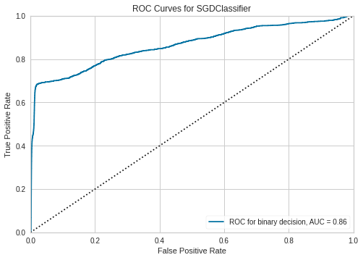
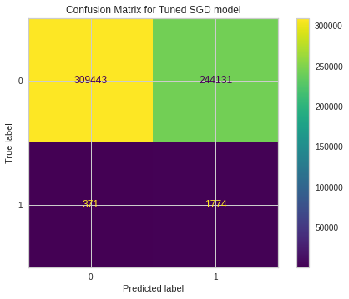
SGD Classifier
The final model we used is SGD Classifier to detect whether the output is fraudulent or not. We also, tuned the NB to improve the performance, the accuracy is 95.3%

Slide 17
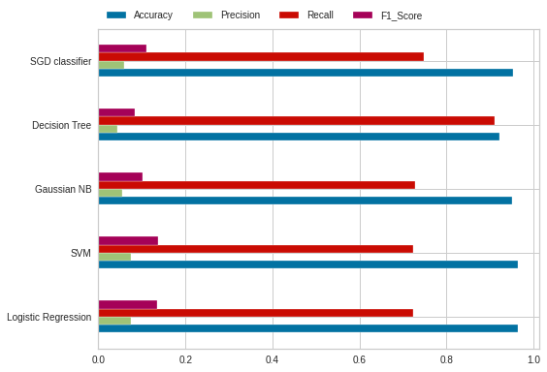
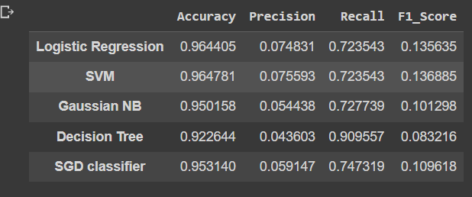
The Champion Model
The Champion model from the Traditional ML model is the Decision Tree with a Recall Value of 90.9%
We used the Recall Evaluation matric to choose the champion model as our case fraud detection, sensitive rate is high and we majored to detect False negative

Slide 18
Ensemble Models
2

Slide 19
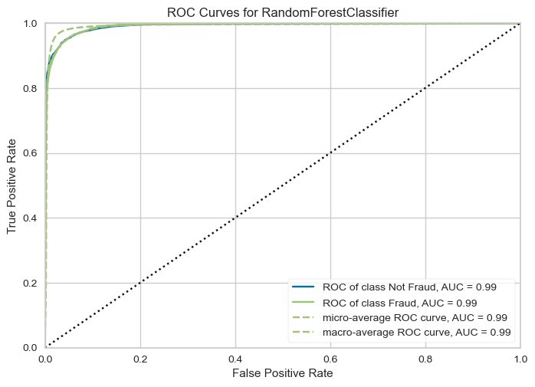
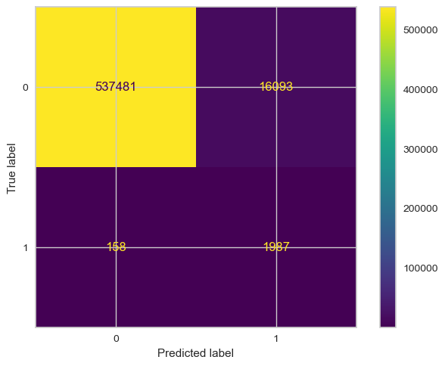
Random Forest Classifier
Random forest Classifier is one of the Bagging Ensemble Learning Classifiers.
Fits a number of decision tree classifiers on various sub-samples of the dataset and uses averaging to improve the predictive accuracy and control over-fitting.

Slide 20
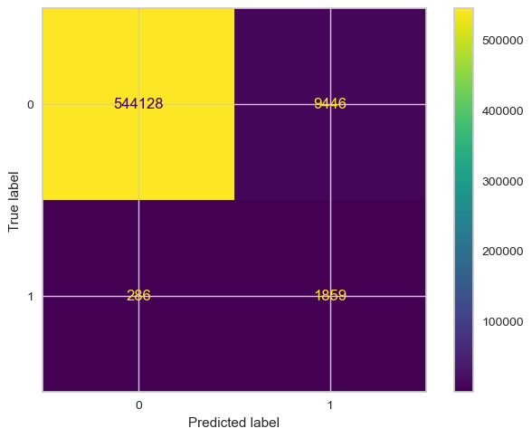
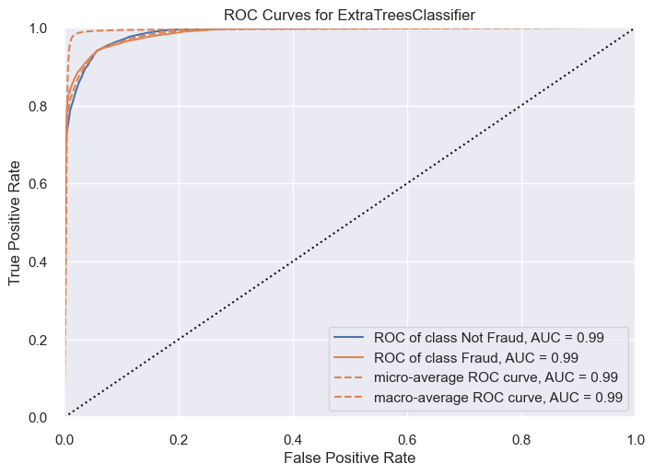
Extra Trees Classifier
Extra Trees Classifier is one of the Bagging Ensemble Learning Classifiers.
Fits a number of randomized decision trees (a.k.a. extra-trees) on various sub-samples of the dataset and uses averaging to improve the predictive accuracy and control over-fitting.

Slide 21
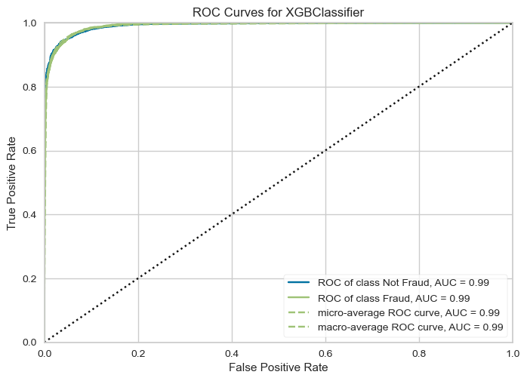

XGBOOST Classifier
XGBOOST Classifier is one of the Boosting Ensemble Learning Classifiers.
XGBOOST is an optimized distributed gradient boosting library designed to be highly efficient, flexible, and portable.

Slide 22


LGBM Classifier
LGBM Classifier is one of the Boosting Ensemble Learning Classifiers.
Light GBM is a gradient-boosting framework that uses a tree-based learning algorithm.
Light GBM grows trees vertically.

Slide 23


Hist Gradient Boosting Classifier
Hist Gradient Boosting Classifier is one of the Boosting Ensemble Learning Classifiers.
Much faster than Gradient Boosting Classifier for big datasets (n_samples >= 10 000).
Based on Decision Trees.

Slide 24
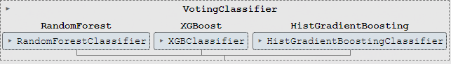
Voting Classifier
Voting Classifier is one of the Stacking Ensemble Learning Classifiers.
Combine different three models together(RandomForest, HistGradientBoosting, LGBM) classifiers

Slide 25
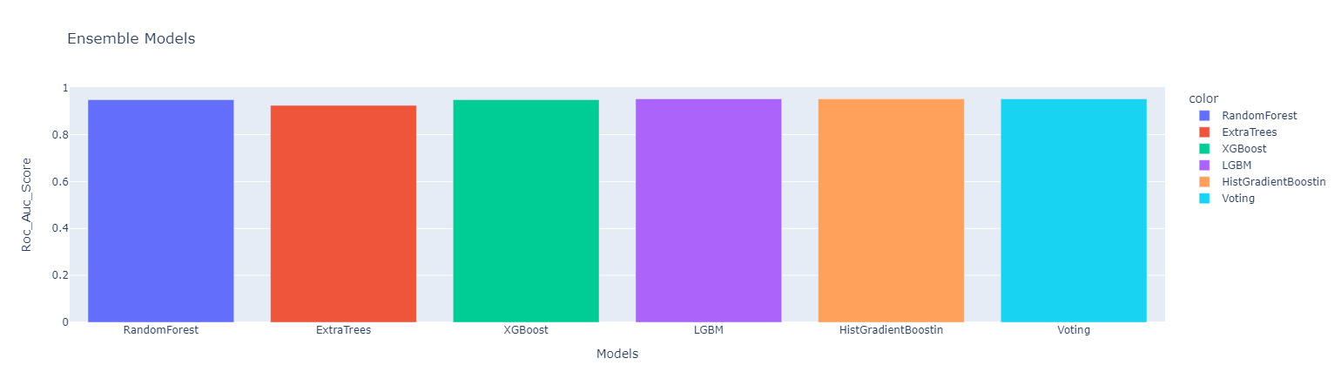
Compare Between Ensemble Models
Hist Gradient Boosting Classifier Model is our Ensemble Champion model and gave us the highest roc_auc score (0.9525143415801215).

Slide 26
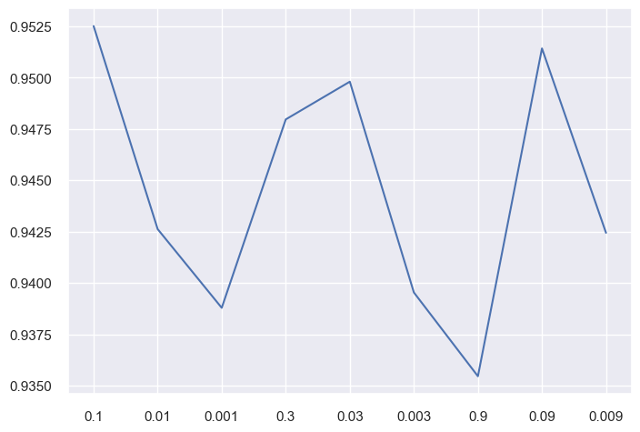
Tunning Hist Gradient Boosting Classifier
We tune the learning rate in Hist Gradient boosting Classifier.
Learning Rate Values: ['0.1', '0.01', '0.001', '0.3', '0.03', '0.003', '0.9', '0.09', '0.009']
The best Learning Rate value after tunning is 0.01 and gave us a roc_auc score of (0.9525143415801215).

Slide 27
Summary
The champion models :
Traditional machine learning is a Decision tree.
Ensemble learning is a Hist gradient boosting classifier.

Slide 28
Thank You

